Slide 1


Team F
Result
Mangement
System
Defense
Presentation - 2023

Slide 2

Table Of Contents
01
About Us
02
Introduction to project
06
Conclusion
03
Objectives
07
Questions
04
Functions
Demonstration
05

Slide 3



Information
About Us
Manoj Shrestha
Leader and Coder
Leads the project and code the program in JAVA programming language interacting with the database.
Nisha Rana
Documentation Writer
Salma Khatun
Documentation Writer
Overall work with the team leader to develop the documents .
Overall work with the team leader to develop the documents .

Slide 4

Definition
What Is Result Mangement System?
Introduction
Result Management System is a technical opportunity for the school, college and university searching for a secure , simple and alternative solution to the conventional paper-based exam results evaluation, reporting and distribution.
System quickens the result management system with unique templates by providing the administration a secure database system for storing, evaluating and publishing the test scores of students online.

Slide 5




Toold Used
Database
MySQL
Programming Language
Java Programming Language
Framwork: Swing and JDBC
Collaboration Tool and Others
Git & GitHub
draw.io

Slide 6
Objectives
To manage all the information about the facilitators and students.
To update the information easily.
To provide the results to the students easily.
To reduce the time for the result making process.
To build a software for result management.
To facilitate the attendance entry process of students by facilitators.
To computerize the paperwork in the system and automate the work.

Slide 7
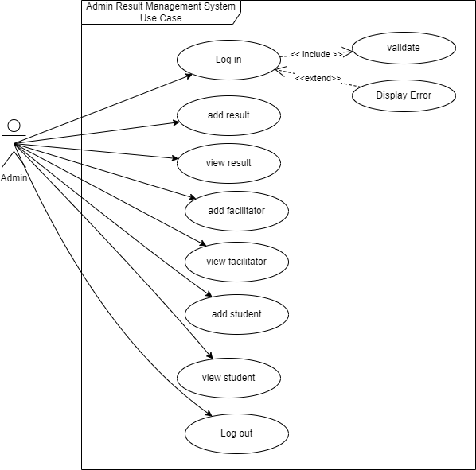
Functions
2021 Archive

Slide 8
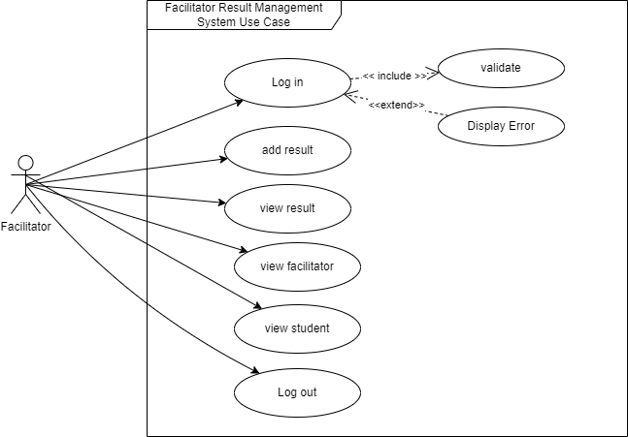
Functions
2021 Archive

Slide 9
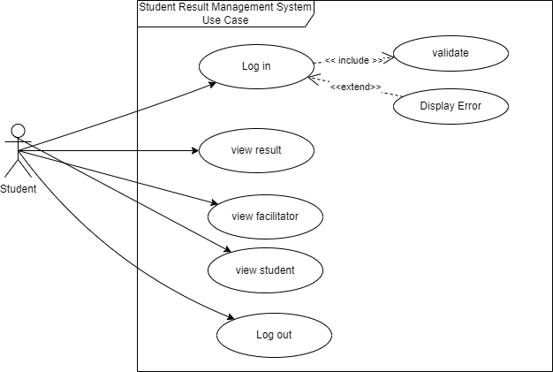
Functions
2021 Archive

Slide 10


DEMONSTRATION
01
02
03
04

Slide 11
QUESTIONS
01
02
03
04

Slide 12

Team F
Thank You
For Your Attention
best of Luck for your
Future Projects too.

